Slide 1

SUGAR-SIGHT: PROACTIVE DIABETES DETECTION Phase 2: Development
April 2nd, 2024
Piyush Gupta, M.S. in Data Science
Practical Data Science, CS 667
pg19322n@pace.edu
Seidenberg School Of CSIS
Pace University, NYC
1

Slide 2
AGENDA
Executive Summary
Project Plan Recap
Data
Exploratory Data Analysis (EDA)
Modelling Methods
Findings
Recommendations & Next Steps
2

Slide 3
EXECUTIVE SUMMARY
Business Problem:
With the growing incidence of diabetes globally, healthcare systems are under pressure to identify and manage individuals at risk efficiently. Early detection of diabetes can significantly enhance patient management and treatment outcomes.
However, manual analysis of vast and complex Electronic Health Records (EHRs) to pinpoint potential cases is time-consuming and often late.
There is a pressing need for an automated solution to accurately predict the onset of diabetes, optimize patient interventions, and allocate medical resources effectively.
Objective:
The objective is to leverage the Diabetes Prediction dataset to develop a robust machine-learning model that can predict the likelihood of diabetes onset in patients with high accuracy.
The goal is to create a predictive model that healthcare professionals can use for early diagnosis and formulate personalized treatment plans.
The model will also help us understand how various medical and demographic factors correlate with the risk of developing diabetes, potentially informing preventive healthcare strategies.
3

Slide 4
PROJECT PLAN RECAP
Deliverable | Details | Due Date | Status
Data & EDA | Identify patterns and factors contributing to the detection of diabetes. | 03/19/24 | Completed
Methods, Findings, and Recommendations | Fill in the methods, findings and recommendations in deck. | 04/02/24 | Completed
Final presentation | Final completed deck | 04/16/24 | In Progress
4

Slide 5
DATA
5

Slide 6
DATA
Data Source: Kaggle (Link to the dataset)
Sample size: (54201 rows, 9 columns)
Time period: 2015 (Electronic Health Records)
Assumptions:
Accuracy of Records: The data extracted from EHRs is assumed to be accurate and to reflect actual patient histories, which means that diagnoses, lab results, and patient information are recorded correctly and are reliable.
Representativeness: The dataset is assumed to represent the broader population the model intends to serve. This includes various ages, genders, BMI values, and other demographic and health-related variables.
6

Slide 7
DATA ALTERATIONS
CLEANING THE DUPLICATES: A total of 3,854 rows were identified as duplicates and subsequently removed to ensure the integrity of the dataset.
CLARIFYING AMBIGUITY: In the smoking history column, we encountered entries labelled 'ever' and 'no info.' Due to their ambiguous nature and lack of clear definitions, these categories have been excluded from the dataset to maintain the accuracy of the analysis.
SPOTTING THE ODD ONES OUT: To enhance the reliability of our health assessments, we meticulously examined our data for any exceptional values that stand out from the norm—referred to as outliers. We thoughtfully excluded these outliers to prevent potential distortion in our analysis.
DATA REFINEMENT: This process is akin to fine-tuning an instrument to ensure it performs its best. By doing so, we refine our predictive models, providing our health forecasts are both accurate and trustworthy.
7

Slide 8
EXPLORATORY DATA ANALYSIS (EDA)
8

Slide 9
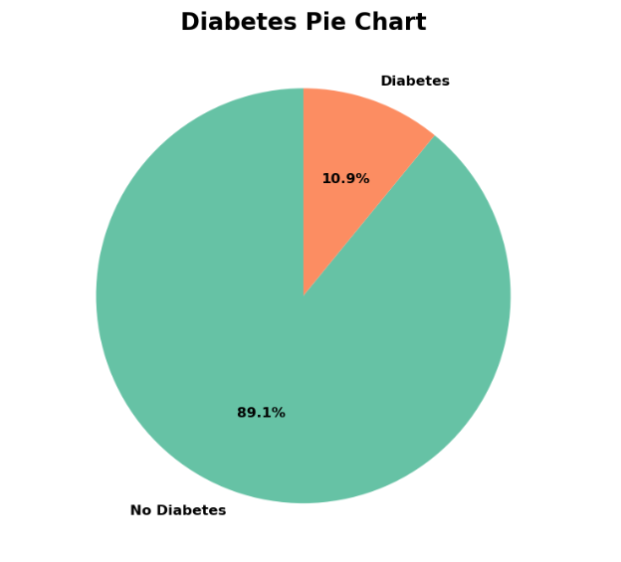
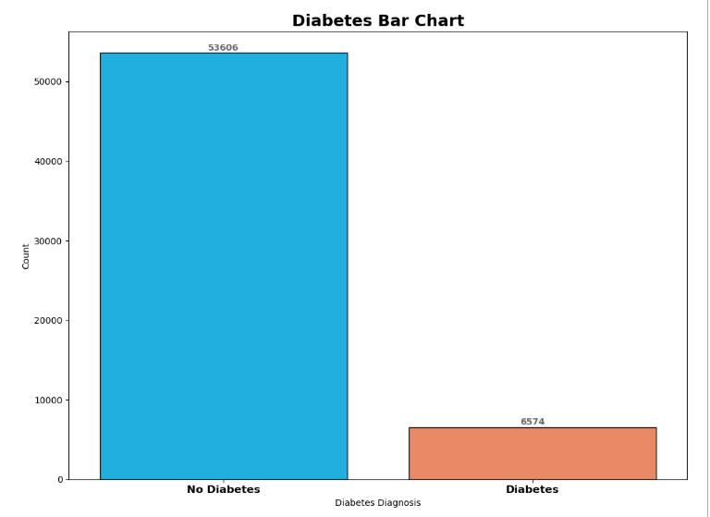
VISUALIZING THE DIABETES DIVIDE
The pie and bar charts clearly show that most of the dataset's subjects do not have diabetes. Only a small fraction, 10.9%, have been diagnosed with diabetes. The class distribution is imbalanced, with 89.1% of the dataset's subjects being non-diabetic.
The data underscores the importance of targeted interventions for the diabetic population, despite their smaller size, which could have important implications for healthcare resource allocation and preventive strategies.
9

Slide 10
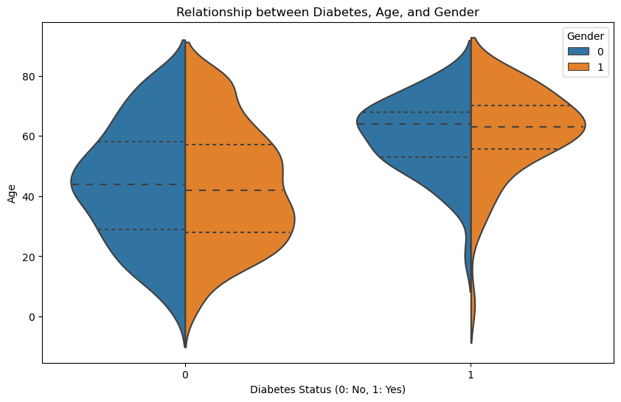
DIABETES PREVALENCE BY AGE & GENDER
Age as a Risk Factor: The plot indicates a broader age distribution among individuals with diabetes, suggesting that older age groups are more represented in the diabetic population.
Gender Distribution: Both genders show a presence in the diabetic category without a stark contrast, implying that both males and females are affected, and interventions should be gender-inclusive.
Targeted Interventions: Age is a clear differentiator in diabetes prevalence, so age-specific preventative measures and screening can be prioritized in healthcare strategies to mitigate the rising incidence of diabetes.
10

Slide 11
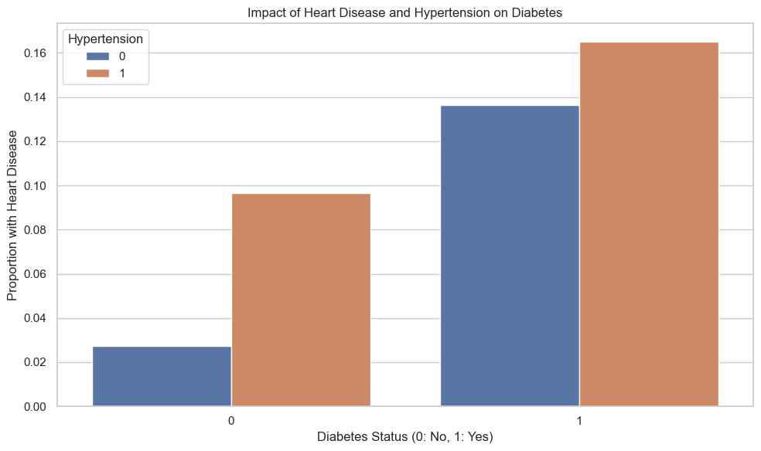
DIABETES LINK TO HEART DISEASE & HYPERTENSION
There is a clear indication that individuals with diabetes have a higher proportion of heart disease compared to non-diabetic individuals, emphasizing the need for cardiovascular health monitoring.
The presence of hypertension raises the proportion of heart disease among diabetic patients, suggesting that hypertension management is crucial to reducing the risk of heart-related complications.
For diabetic individuals, especially those with hypertension, preventive measures and regular screenings for heart disease could be vital in reducing morbidity and improving outcomes.
11

Slide 12
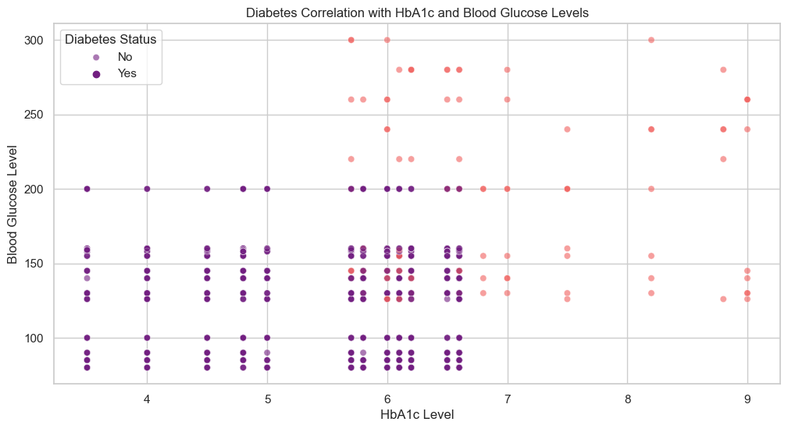
GLUCOSE vs HBA1C: DIABETES INDICATORS
There's a visible distinction in blood glucose and HbA1c levels between individuals with and without diabetes, with diabetic individuals tending to have higher values in both measures.
Blood Glucose Variability: Blood glucose levels show significant variability among those with diabetes, underscoring the importance of regular monitoring and individualized treatment plans to manage the condition effectively.
HbA1c Consistency: HbA1c levels among non-diabetics remain consistently within a narrower range, reinforcing its reliability as a long-term indicator of glycaemic control.
NOTE: Refer to the appendix slide for technical reasoning on the significance of these features.
12

Slide 13
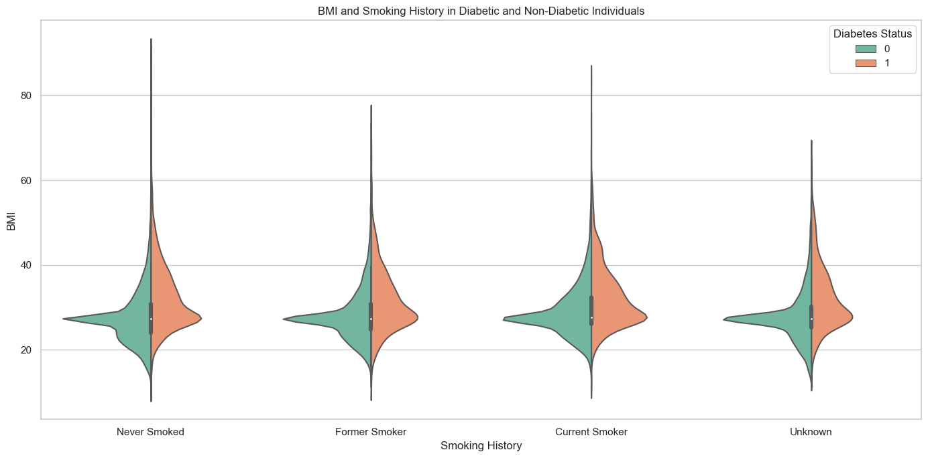
SMOKING, BMI & DIABETES RISK
Diabetes Prevalence: Individuals with diabetes tend to have a higher BMI across all categories of smoking history.
Unknown Smoking History: The 'Unknown' smoking status group has a wide BMI distribution for diabetic individuals, hinting at the possibility of undetermined risk factors in this subgroup.
BMI distributions are broad across different smoking histories, suggesting that BMI is a factor irrespective of smoking status.
Health campaigns could be designed considering both smoking status and BMI management, as both factors influence diabetes risk.
13

Slide 14
MODELING METHODS
14

Slide 15
FROM BIAS TO BALANCE: A Fruitful Approach To Fair Predictions
1. The Challenge of Imbalance:
Imagine a bowl mostly filled with apples (no diabetes) and just a few oranges (diabetes) – that's class imbalance.
A computer model trained on this may overlook the oranges, just like missing a vital diagnosis.
2. Addressing the Imbalance:
Oversampling: Adding more oranges to balance the bowl, teaching the model about both fruits equally.
Undersampling: Removing some apples to make room for the oranges, aiming for a balanced mix.
15

Slide 16
FROM BIAS TO BALANCE (Continued)
3. Choosing Our Path:
Oversampling was the better choice, reducing false alarms while identifying most true cases.
Undersampling was less effective as it led to too many false diabetes alerts.
4. Why Logistic Regression:
It's a simple, clear-cut method, like predicting rain with a 'yes' or 'no.'
It is known for its clarity and everyday use in medical settings.
With a now balanced dataset from oversampling, it can make fair and accurate predictions.
5. Conclusion:
Oversampling + Logistic Regression = A well-behaved, fair, and effective model for our needs.
16

Slide 17
MODELING METHODS
OUTCOME VARIABLE: Our goal is to predict the presence of diabetes in individuals. This enables us to identify at-risk patients early, allowing timely interventions and better management of health outcomes.
FEATURES:
Our crucial indicators are age, BMI (Body Mass Index), HbA1c level (a measure of blood sugar levels over the past three months), Blood glucose level, Hypertension, Heart disease, smoking history and gender.
These features are pivotal in assessing the likelihood of diabetes, providing deep insights into the correlation between physiological markers and the onset of diabetes.
MODEL TYPE: LOGISTIC REGRESSION
Logistic regression is akin to a diagnostic test that estimates the probability of an event (diabetes) occurring, making it suitable for binary classification tasks.
It assesses the relationship between our binary outcome (diabetes: yes or no) and one or more predictor variables (age, BMI, HbA1c, blood glucose level and so on).
This model type is interpretable and helps indicate the relationship between the likelihood of diabetes and the predictors, which is invaluable for medical professionals making informed decisions.
17

Slide 18
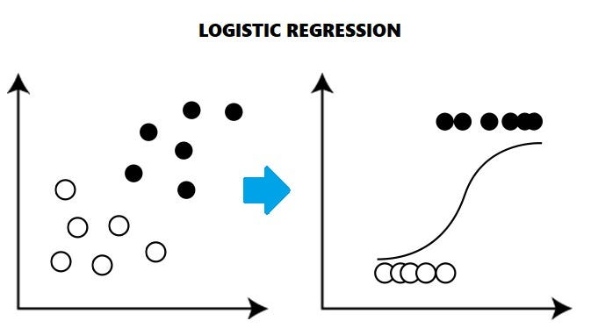
MODELING METHODS (continued)
MODEL TYPE: LOGISTIC REGRESSION
Focused Prediction: Logistic regression provides a focused approach to predicting binary outcomes such as the presence or absence of diabetes.
Probability Estimates: Unlike models that only classify, logistic regression provides the probability of the outcome, offering a nuanced understanding of diabetes risk.
Simple and Efficient: Logistic regression is computationally less intensive, allowing for quick model training and validation on large datasets.
Feature Significance: This method evaluates the significance of each feature, helping to identify the most influential factors in diabetes onset.
NOTE: Refer to the appendix slide for technical reasoning on Logistic Regression.
18

Slide 19
FINDINGS
19

Slide 20
OUR INSIGHTS: Diagnosing Diabetes Effectiveness
1. MODEL PERFORMANCE METRICS:
Overall success rate: Accuracy (83%) - Our model accurately predicts diabetes status in 83% of cases.
A closer look: Precision (27%) - When the model predicts diabetes, it is correct about 27% of the time. We're looking to improve this, so we don't worry people unnecessarily.
2. DECODING THE METRICS:
The model is accurate overall, meaning it usually makes the right call on whether someone has diabetes. But it's a bit on the cautious side, sometimes missing people who do have diabetes.
When the model does flag someone as having diabetes, it's usually correct, which is good because we want to avoid alarming people unnecessarily.
We need to fine-tune the model a bit more to catch more of the confirmed cases of diabetes. By doing so, we can help people get the treatment they need sooner.
20

Slide 21
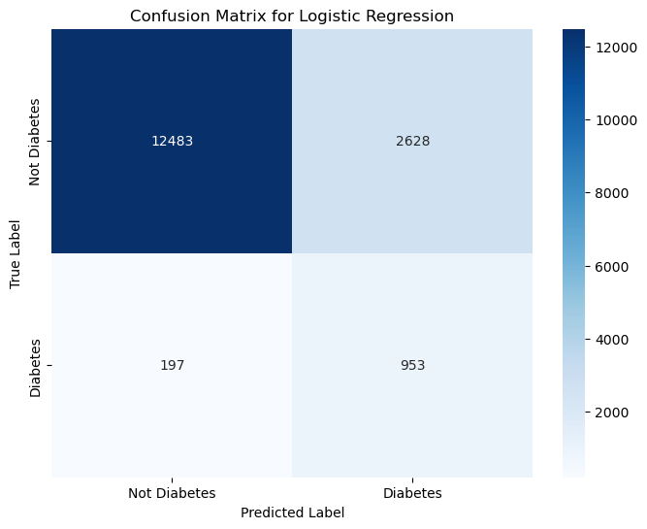
DELVING INTO DETAILS (Our Insights Continued)
3. CONFUSION MATRIX: Understanding our predictions
Healthy High-Five (True Negatives): Imagine a large room with 12,483 healthy people; our model would correctly say they're all fine.
Good Guesses (True Positives): We'd successfully identify 953 people with diabetes in a smaller room.
Oops, Sorry! (False Positives): In another room, we might accidentally tell 2,628 healthy people they have diabetes. That's why we want to get better at this.
Nearly Missed (False Negatives): Lastly, out of a group of people who have diabetes, we might miss 197 of them, which reminds us how important it is to keep improving.
21

Slide 22
RECOMMENDATIONS & NEXT STEPS
22

Slide 23
STRATEGIC ENHANCEMENTS: Turning Insights Into Actions
KEY FINDINGS:
Our current model offers a promising start, but there's room to grow in accurately identifying diabetes.
The model excels in identifying those without diabetes but is less precise when confirming cases, signalling a need for refinement.
LINKING TO OUR GOAL:
Precise diabetes prediction is fundamental for efficient healthcare planning and personalizing patient care.
Overlooking diabetic patients may result in delayed treatment, affecting health outcomes and healthcare efficiency.
ACTIONABLE RECOMMENDATIONS:
Craft personalized follow-up plans for at-risk patients, utilizing data-driven insights to provide nutritional counselling, exercise programs, and regular health check-ups to prevent diabetes progression.
Implement a continuous feedback loop where patient outcomes contribute to model learning, enhancing predictive accuracy and care pathways.
23

Slide 24
NEXT STEPS: Evolving our Insights
Refining Our Predictive Model:
Objective: Boost the prediction accuracy for diabetes onset.
Approach: Implement advanced algorithms like artificial neural networks or boosted trees that can discern subtler patterns and interactions among medical indicators.
Enriching Our Data Landscape:
Objective: Achieve a holistic view of factors contributing to diabetes.
Approach: Integrate broader health determinants, including lifestyle data, genetic information, and environmental factors, to enrich our analysis.
Empowering Patient Engagement:
Objective: Foster proactive health management among individuals at risk.
Approach: Develop tools/apps that encourage timely medical consultations based on model indications.
Strengthening Decision Support Systems:
Objective: Provide robust analytical support for healthcare providers.
Approach: Integrate the model within clinical decision systems for real-time, evidence-based recommendations.
24

Slide 25
APPENDIX
25

Slide 26
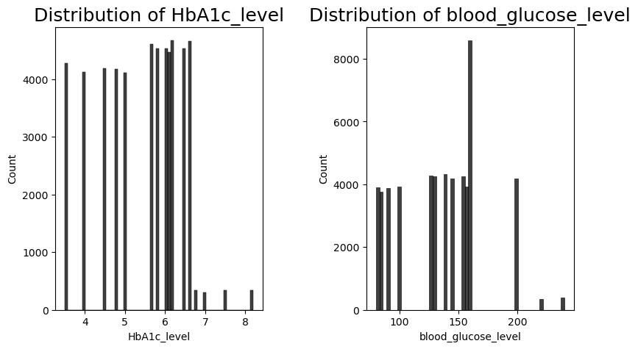
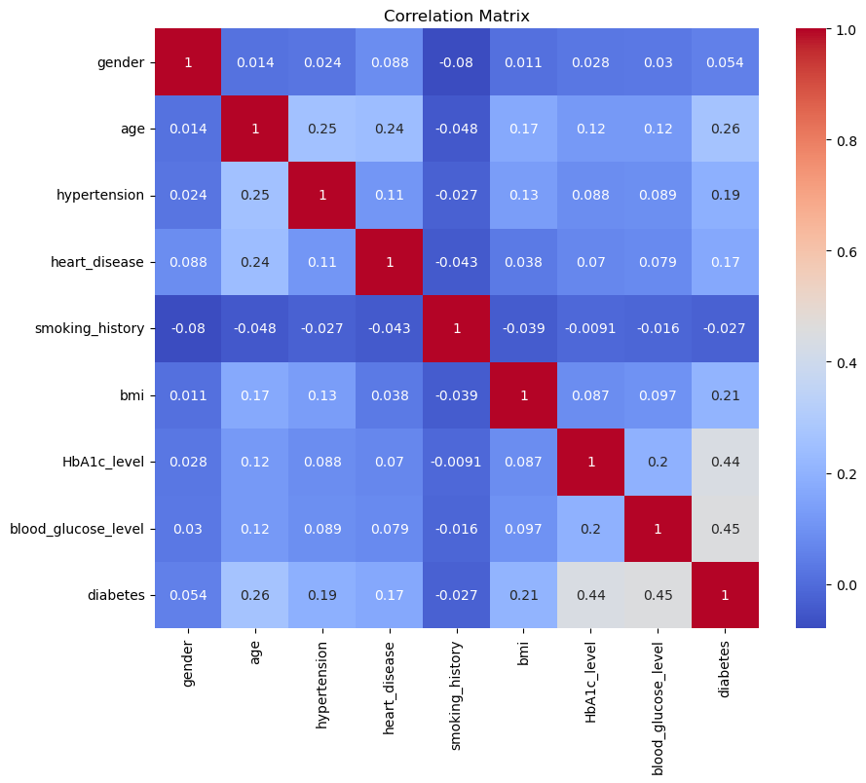
SIGNIFICANCE OF Glucose & Hba1c levels
HbA1c Level Significance: Its distribution suggests a concentration around the clinical threshold that separates non-diabetic from potentially diabetic individuals, making it a crucial predictor. Its correlation with diabetes (0.44) in the correlation matrix confirms its strong relationship with the condition.
Blood Glucose Level Significance: The distribution shows varying concentrations, with spikes at specific intervals, which may correspond to standard clinical thresholds for diabetes diagnosis. Its correlation with diabetes (0.45) in the correlation matrix indicates its direct impact on diabetes status and supports its inclusion as a predictive feature.
26

Slide 27
MODELLING METHODS: TECHNICAL REASONING
Binary Outcome Suitability: Logistic regression is explicitly designed for binary classification tasks. Since diabetes prediction involves distinguishing between the presence and absence of the condition, logistic regression is naturally fit for this purpose.
Probabilistic Interpretation: Logistic regression models the probability of the target variable belonging to a particular class, which is valuable for medical diagnoses where understanding the risk probability is as important as the classification.
Feature Relationships: The model provides coefficients representing the outcome's log odds, which can be interpreted into odds ratios. This allows for a direct understanding of how each feature (e.g., age, BMI) affects the likelihood of diabetes.
Regularization Capabilities: Logistic regression can incorporate regularization to prevent overfitting, which is crucial when the dataset has many features or features with multicollinearity.
27

Slide 28
ADDITIONAL INFORMATION
GIT REPOSITORY: Link to the github repository
28

Slide 29
THANK YOU
29

